Slide 1
If statements and For Loops
Objectives
Review conditional formatting
Understand the structure of an if statement
Understand how loops operate on data
Debugging loops
Vectorization – an alternative to the loop

Slide 2
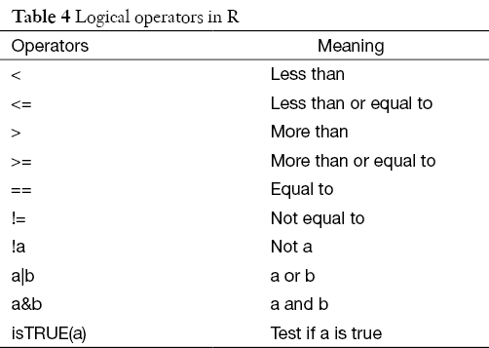
Conditional operators in R

Slide 3
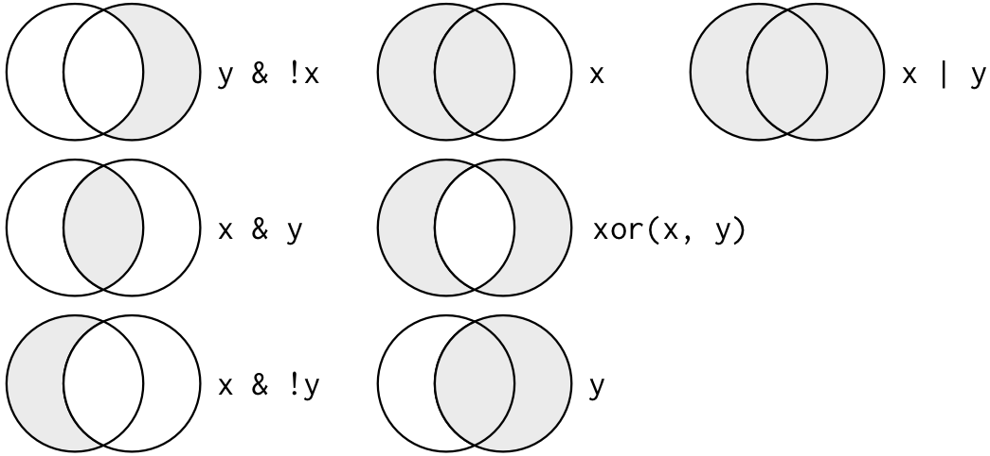
Conditional operators in R

Slide 4
Functions used
If(condition){
do something
} else{
do something else
}
for(i in start:finish){
do something
}

Slide 5
Exercise #5
Read the hw_dat.csv file
Calculate the mean fish length
Write an if statement to determine if a value is larger or smaller than the mean fish length
Write a loop to create a new variable ‘sizeCategory’. Populate this variable with the values ‘large’ or ‘small’ depending on whether the fish is larger or smaller than average

Slide 6
Functions!
Objectives
Understand why we would want to use a function
How to develop a function algorithm
Learn practices for debugging a function

Slide 7
Functions used
Ifelse
function(inputs){
do something
}

Slide 8
Exercise #6
Read in the ‘Fish.catch.csv’
Write a function with the following steps:
Determine if the file contains the variable ‘TL.mm’
If it does, calculate the mean TL for each species

Slide 9
Basic Statistics
Objectives
Review data visualization methods prior to analysis
Run statistical analyses
Linear regression
logistic regression
Explore data output
Look at model diagnostics

Slide 10
Functions used
lm()
glm()
qqnorm()

Slide 11
Exercise #7
Read the file ‘Habitat data.csv’
Explore the data with plots to make sure everything looks correct
Fit a linear regression to determine if there is a relationship between pool length and pool width
What is the r2?
Make some diagnostic plots to determine if the model looks reasonable

Slide 12
Advanced graphics w/ ggplot
Objectives
Learn about the capabilities and flexibility of ggplot

Slide 13
Functions used
ggplot()
geom_point()
geom_smooth()
facet_wrap()

Slide 14
Exercise #8
Read the file dat.csv
Plot fish weight as a function of fish length using ggplot
Change color of symbols for each year in the study
Create a new plot that separates each year into a new facet
Add a smoothed line to the plot

